Slide 1
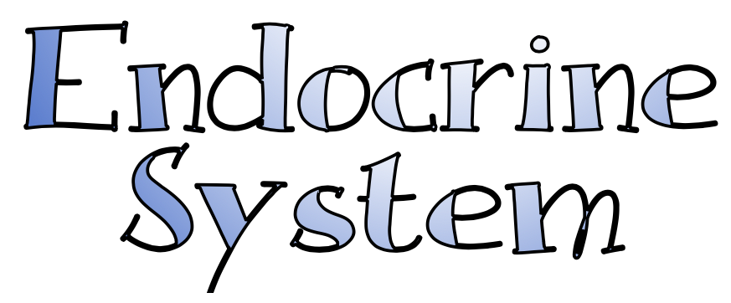

Slide 2
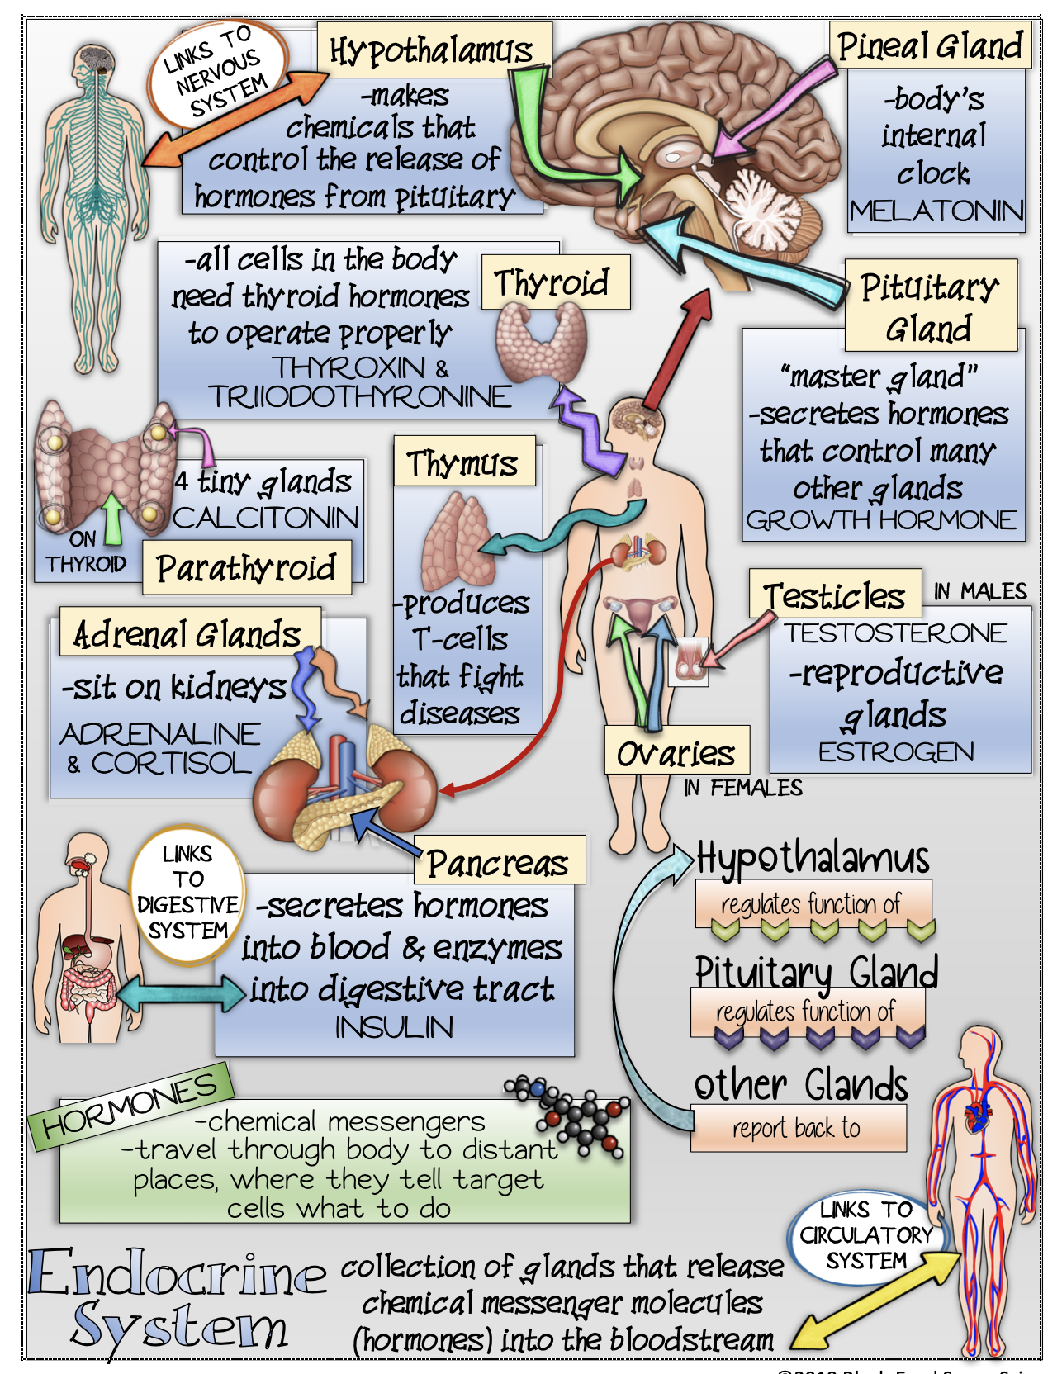

Slide 3
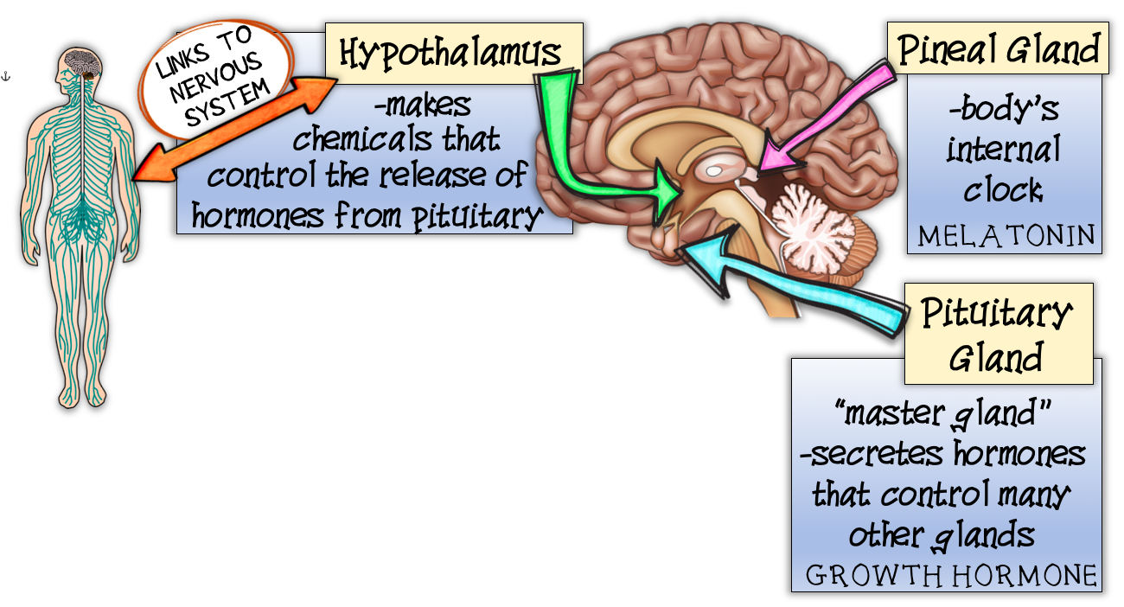

Slide 4
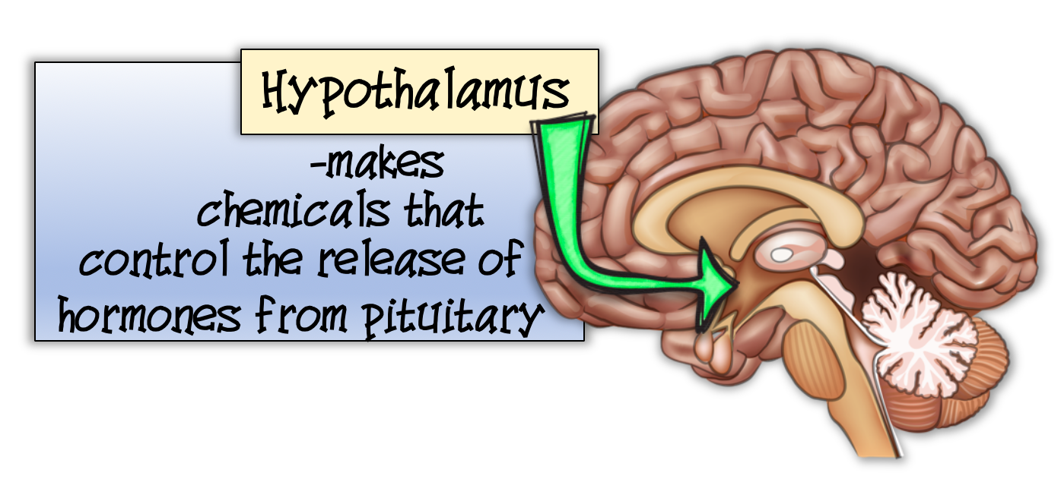

Slide 5
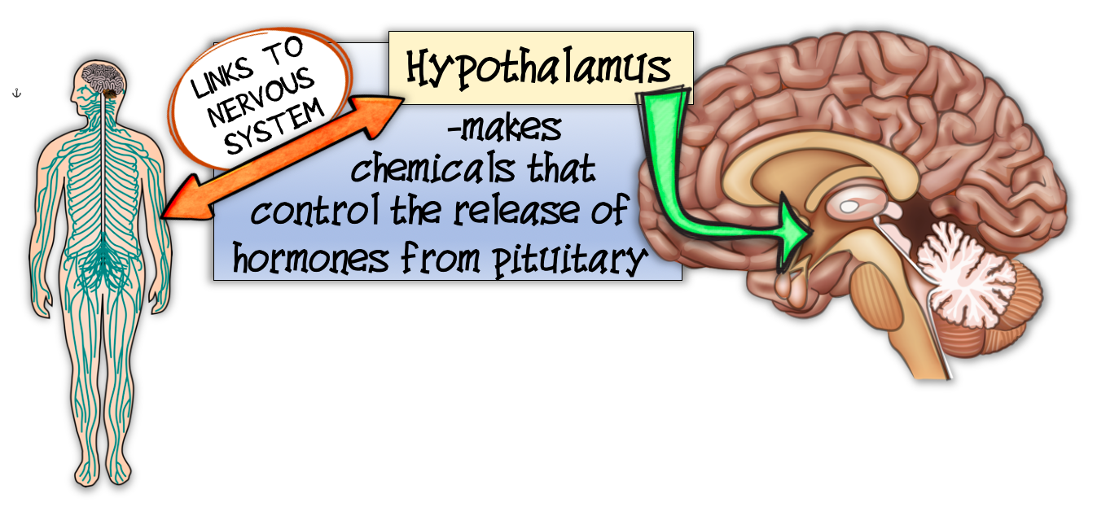

Slide 6
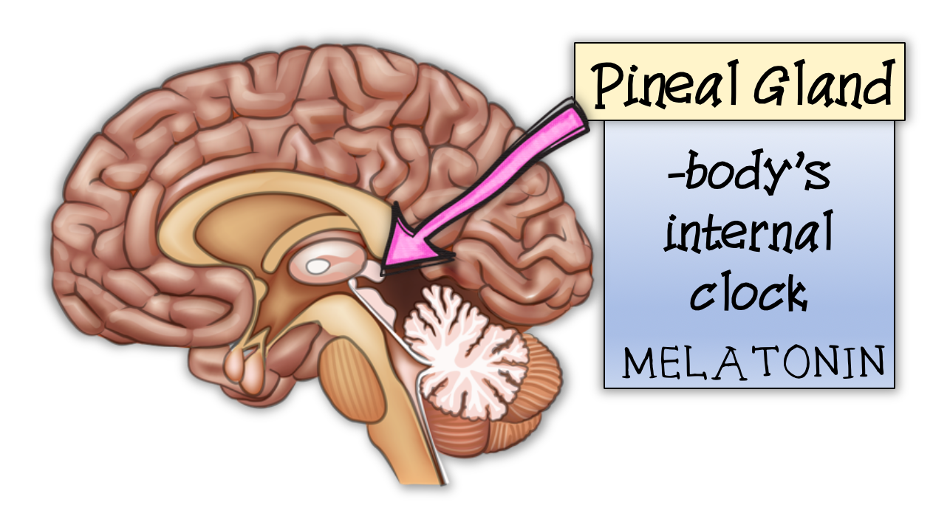

Slide 7
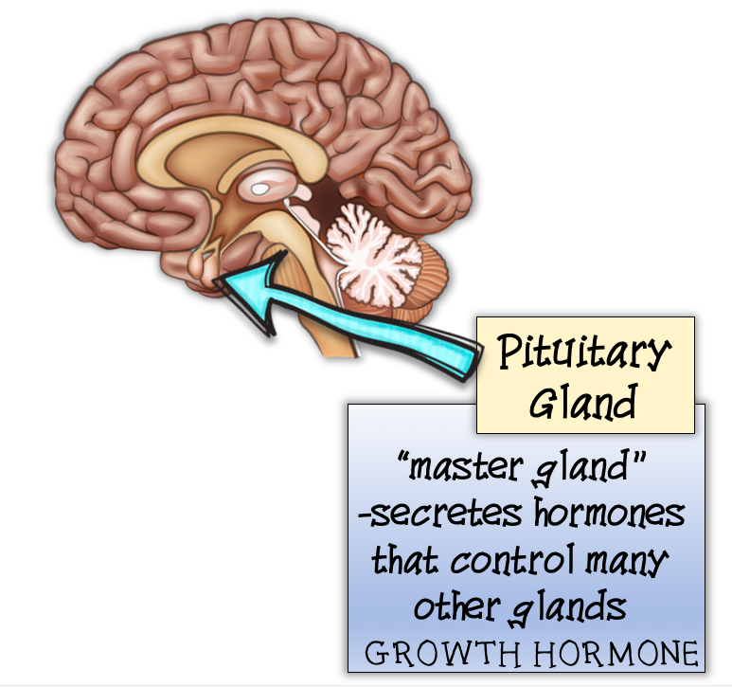

Slide 8
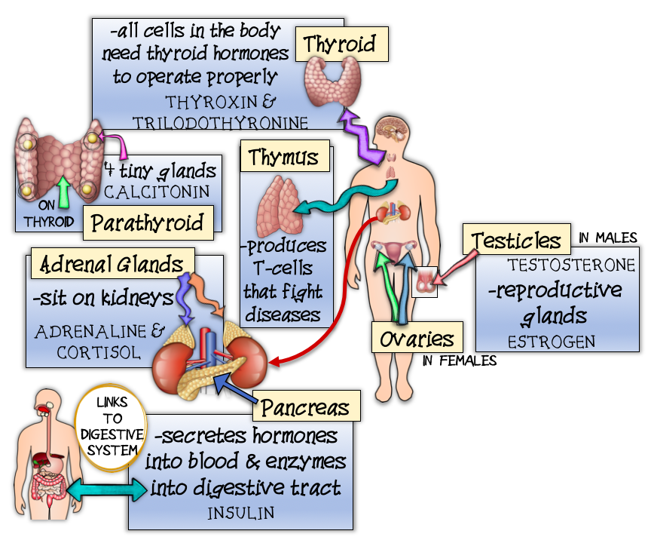


Slide 9
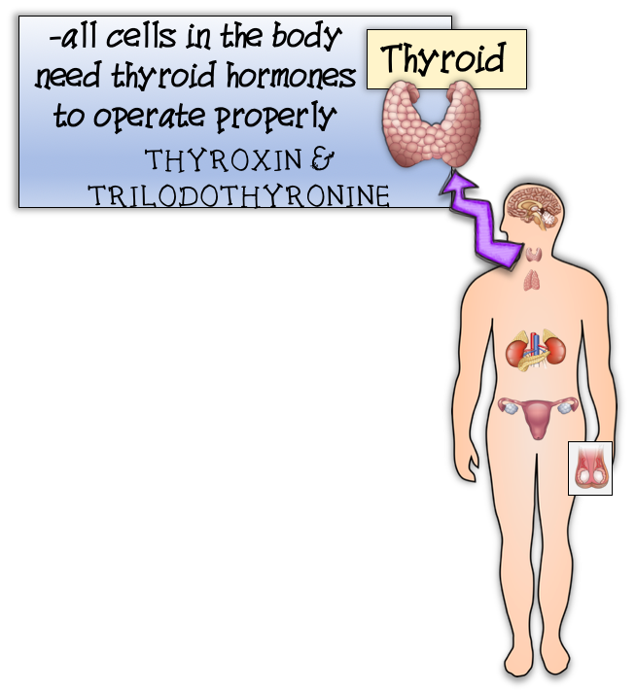

Slide 10
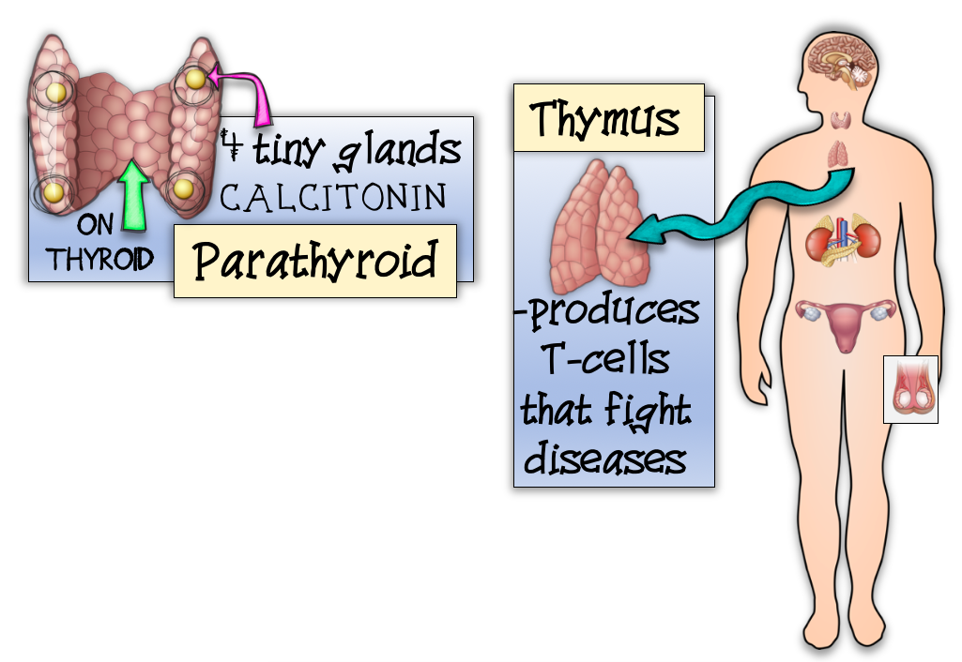

Slide 11
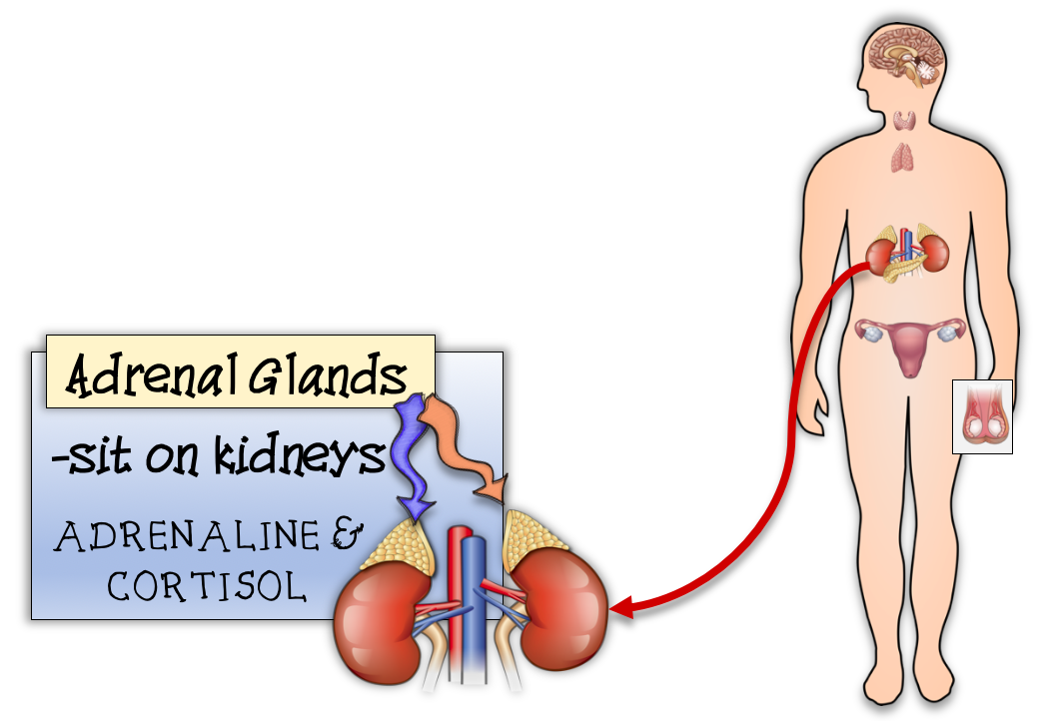

Slide 12
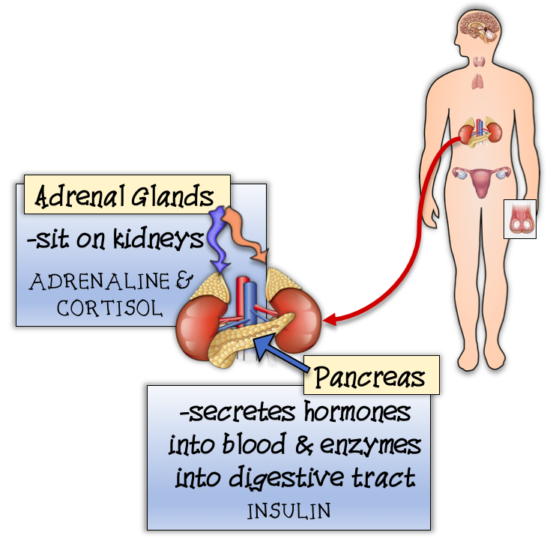

Slide 13
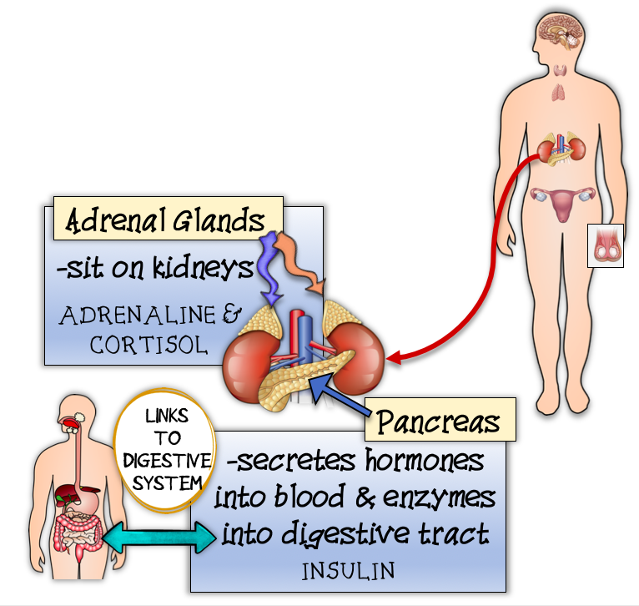

Slide 14
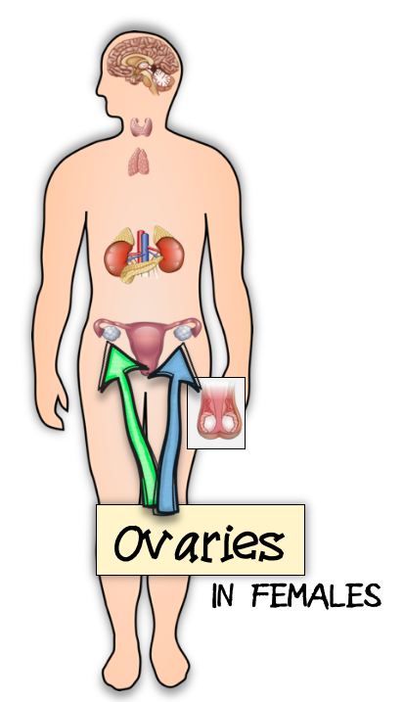

Slide 15
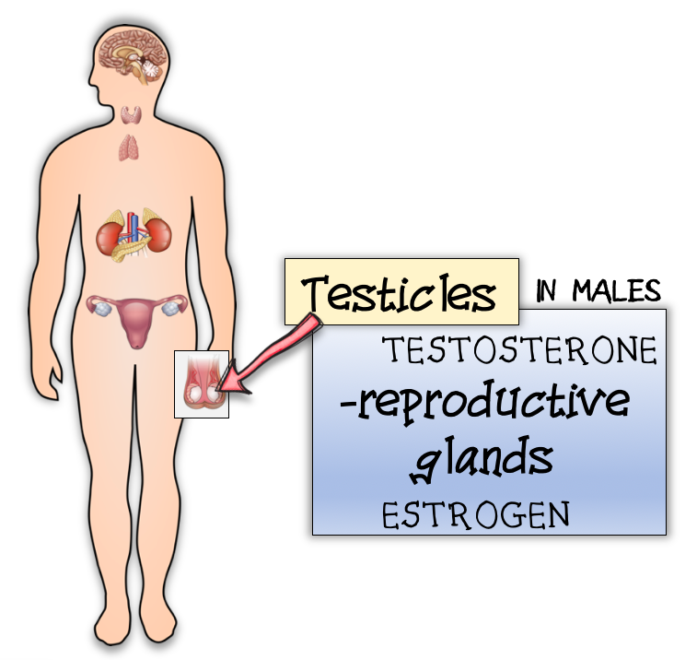

Slide 16
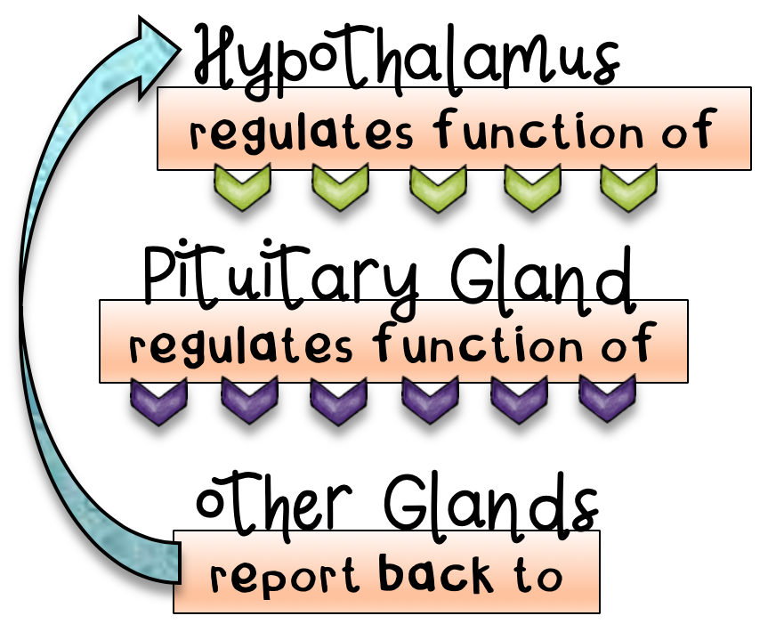
Interpreted as:
The hypothalamus regulates the function of the pituitary gland.
The pituitary gland regulates the function of the other glands.
The other glands report back to the hypothalamus.

Slide 17
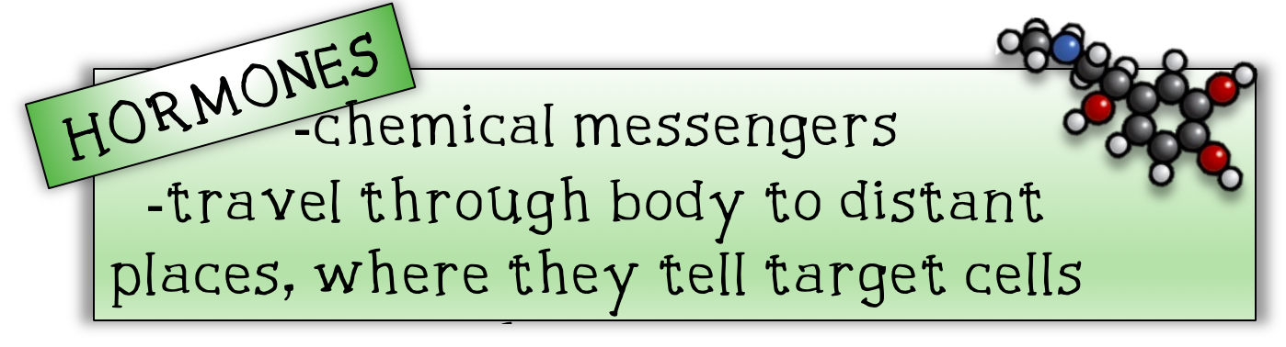

Slide 18
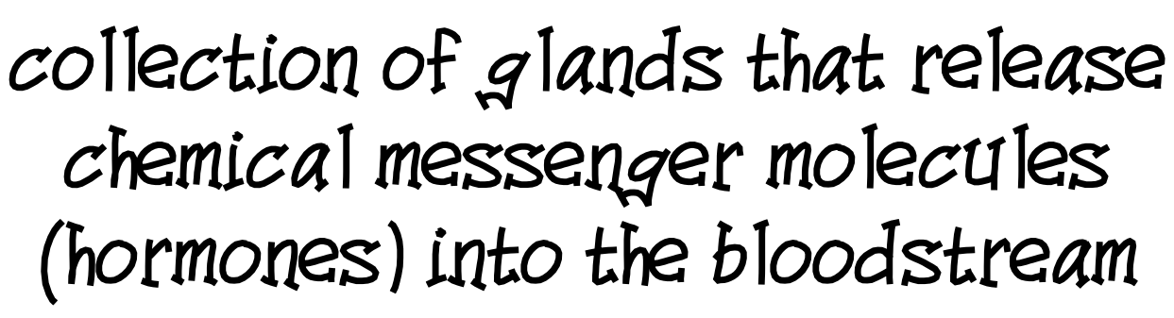

Slide 19
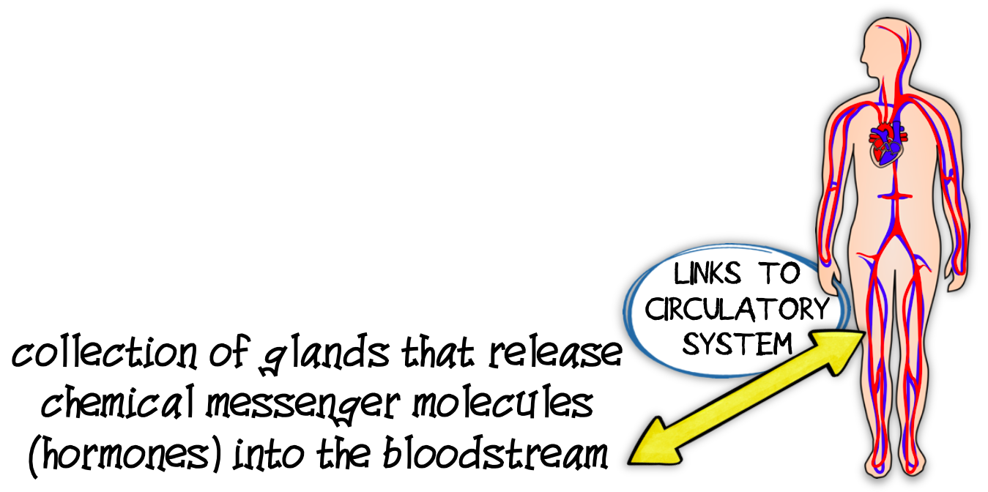

Slide 21
Credits and Copyright
Black-Eyed Susan Science
Next Generation Science Standards
Digital Mojo
Sarah Pecorino Illustration
Julie Ridge Designs
Teachers Resource Force
The Cher Room
Kimberly Geswein Fonts
Teach To Tell
Amy Groesbeck
https://images.app.goo.gl/L12BDTkNcW3jZoWk6

